Slide 1

HandwrittenDigitClassifier
Project Synopsis Presentation
Industrial Training(ID)
Degree :Btech
Project Guide:
FACULTY OF ENGINEERING & COMPUTING SCIENCES
TEERTHANKER MAHAVEER UNIVERSITY, MORADABAD

Slide 2

Team Details
Student Name | Role
Guidelines: Mention Team Names & their role in project
2
T011A/ Template Version 5.0

Slide 3
Project Brief
This project aims to develop an advanced deep learning-based handwritten digit recognition system using Convolutional Neural Networks (CNN) with high accuracy and reliability.
By leveraging the MNIST dataset along with powerful image processing and machine learning techniques, the system automatically learns and extracts features from handwritten digit images for precise classification.
The solution enhances automation in various domains such as banking, postal services, and document digitization by accurately recognizing handwritten digits and improving productivity.
Guidelines: Mention brief about the project and it’s functions/ modules
3
T011A/ Template Version 5.0

Slide 4
q
Methodologies/ Technologies/ Tools to be used
This project utilizes Python programming language along with powerful libraries such as TensorFlow and Keras for building and training the Convolutional Neural Network (CNN) model.
Data handling and preprocessing are performed using NumPy and Pandas, while Matplotlib and Seaborn assist in visualization and analysis of data and model performance.
The entire implementation is carried out in the interactive Jupyter Notebook environment, enabling seamless coding, visualization, and documentation in one platform.
The methodology follows a structured pipeline including dataset preprocessing, model building, training, validation, and testing to achieve efficient and accurate handwritten digit classification.
4
T011A/ Template Version 5.0

Slide 5
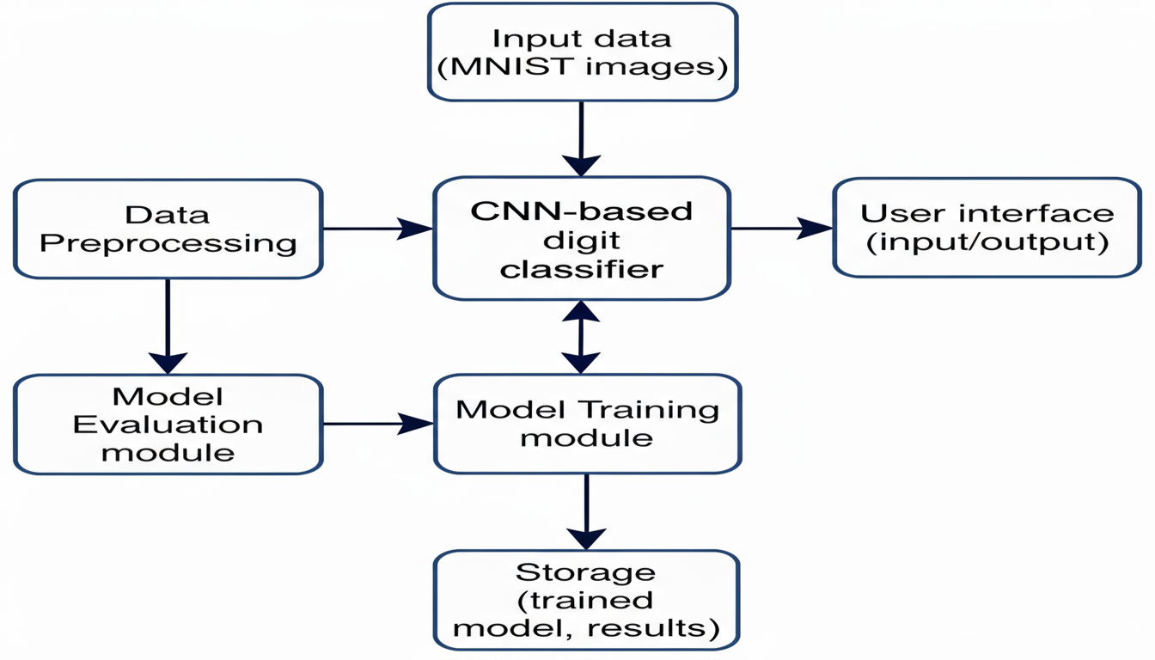
Context Diagram (Overall Project)
5
T011A/ Template Version 5.0

Slide 6
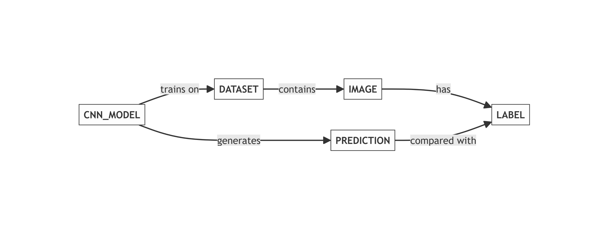
Entity Relationship Diagram (ERD)
6
T011A/ Template Version 5.0

Slide 7
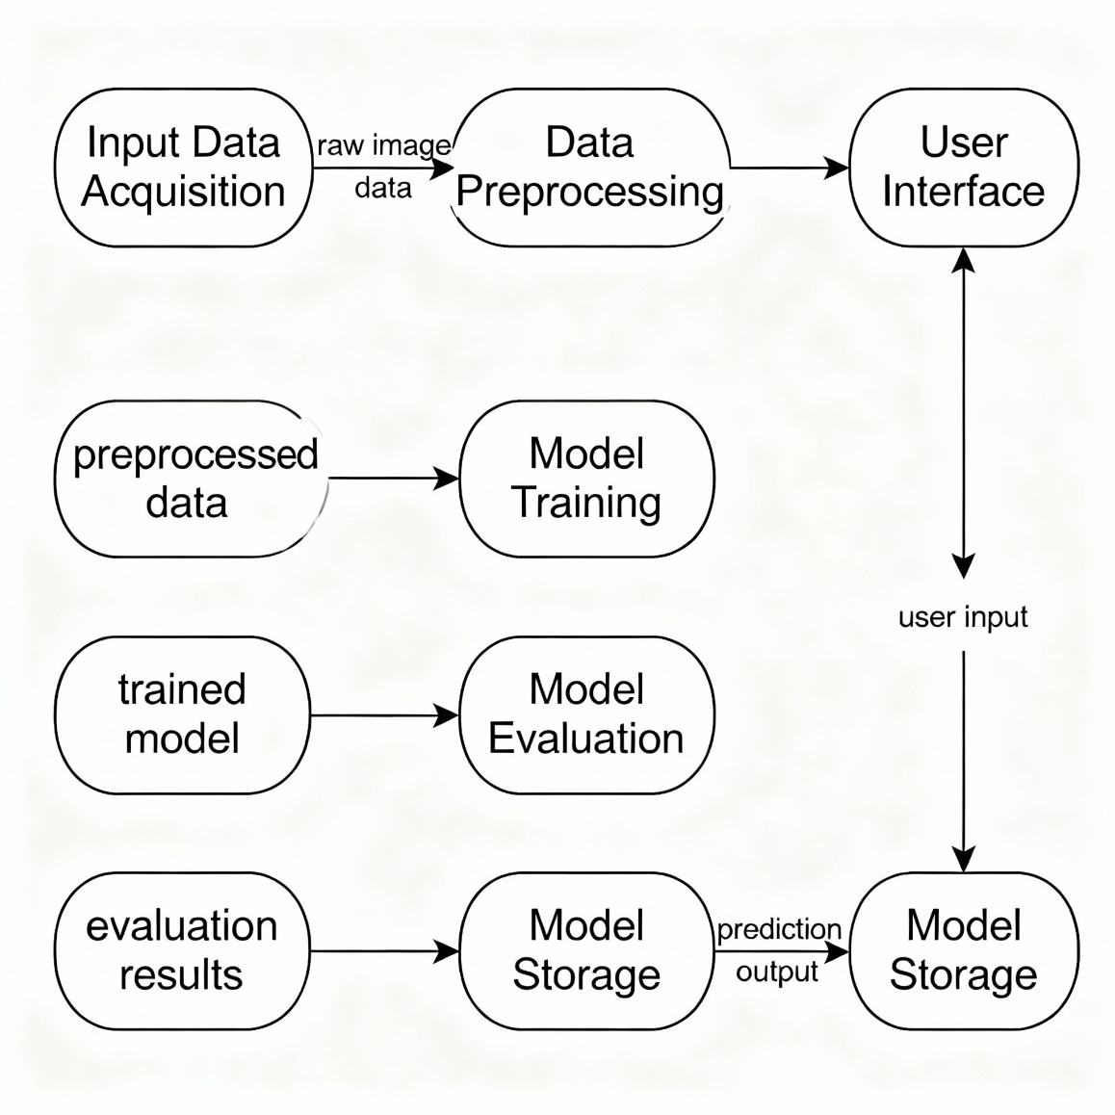
Data Flow Diagram (DFD)
Guidelines: Add more slides, if required to show all DFDs
7
T011A/ Template Version 5.0

Slide 8
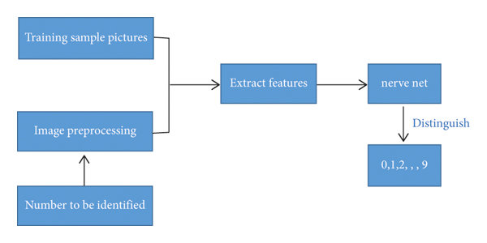
Flow Chart
Guidelines: This slide is optional
8
T011A/ Template Version 5.0

Slide 9
\
Advantage of The Project
High accuracy with Convolutional Neural Networks (CNN) for reliable digit recognition
Automates digit recognition for applications like mail sorting and form processing
Fast classification improves operational efficiency compared to manual methods
Scalable approach, adaptable for other handwritten characters or image recognition
Robust system handles various handwriting styles and image qualities
Built with open-source libraries for easy reproduction and community support
Serves as an educational tool for learning deep learning and AI model development
Guidelines: Mention advantage from this project, the audience/ users who will get benefitted
9
T011A/ Template Version 5.0

Slide 10
References, if any
TensorFlow Datasets: MNIST. https://www.tensorflow.org/datasets/catalog/mnist
Keras API: MNIST Dataset. https://keras.io/api/datasets/mnist/
Goodfellow (2016): A thorough textbook on deep learning covering the theory and practical applications of neural networks including CNNs, which are central to handwritten digit recognition.
10
T011A/ Template Version 5.0

Slide 11
THANKS

